Slide 1
Sign Language Translator Using Machine Learning
R.M.D ENGINEERING COLLEGE
DEPARTMENT OF ELECTRONICS AND COMMUINICATION ENGINEERING
Presented By
Mavuluru Viswajith Reddy (111515106083)
Kollipara Hemanth Gupta (111515106064)
Malepati kalyan Kumar Chowdary (111515106076)
Madana Naren Guru Sai (111515106070)
Project Guide
Dr. K Helenprabha

Slide 2
ABSTRACT
The communication between normal person and deaf/dumb person is always challenging task.
Sign language is the main communication medium of the impaired people. It contain gestures instead of sound to elaborate the meaning.
This project enables communication between dumb/deaf people and common people.

Slide 3
Existing Method :
Conversion of sign language into audio/display by recognising of gestures with limited data set which involves more time.
Proposed Method :
The recognition rate of gestures is increased and the portable nature of the device helps the users to obtain results in quicker and efficiently by the use of machine learning.

Slide 4
WORK PLAN
The Samples of the gesture are collected and stored in the form of records
When the Actions are been performed the system will collect the data.
Prediction will be done depending on the collected samples and the collected data

Slide 5
BLOCK DIAGRAM
User
(Machine Learning)
Bluetooth
Flex sensors
Lilypad
Data collection
Analysis
Monitor
MPU6050

Slide 6
FLOW CHART
Calibration process
start
Read sensors values
Map sensors reading
sensors reading =stored values”letter found”
Display in monitor

Slide 7
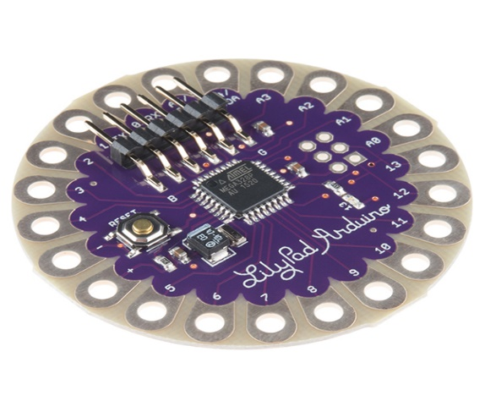
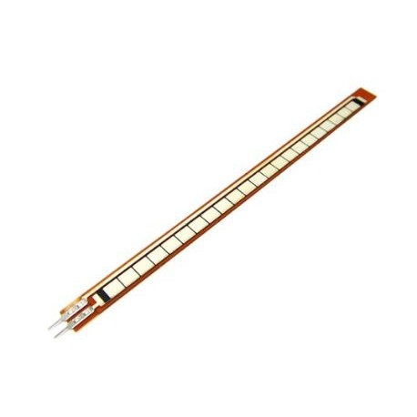
REQUIREMENTS
Arduino Lilypad
Flex Sensors
Gyroscope
Accelerometer
Bluetooth Module
16 Channel Analog Multiplexer
Conductive Thread
5V Battery Supply
Gloves

Slide 8
Arduino Lilypad
The LilyPad is designed for e-textiles and wearables projects. It can be sewn to fabric and similarly mounted power supplies and sensors with conductive thread.
Flex Sensor
This flex sensor is a variable resistor like no other. The resistance of the flex sensor increases as the body of the component bends.
MPU6050
The MPU-6050 Motion Tracking devices designed for the low power, low cost, and high-performance requirements of smartphones, tablets and wearable sensors.

Slide 9
FEATURES
It can store the Samples in the form of records and can predict the outcome in fast and accurate way
Teaching new instructions is much simpler and doesn’t need any coding or technical skill.
Prediction rate can be increases by the load store of the records.
The Records can be easily shared with the devices with any cables.

Slide 10
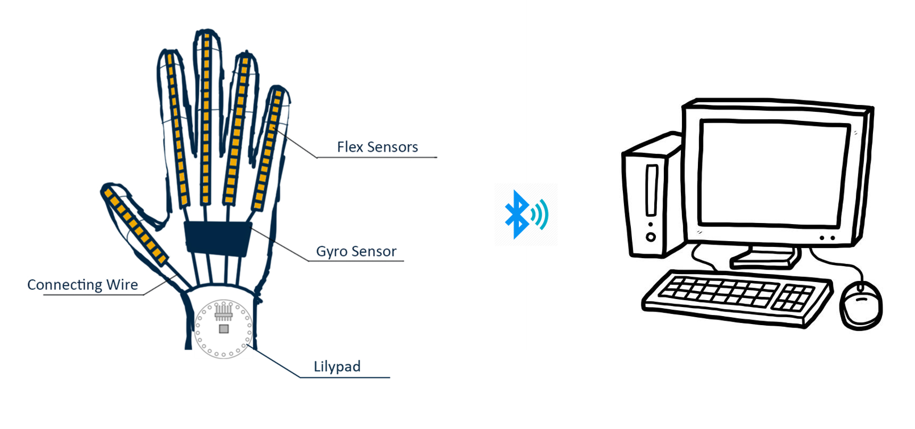
DESIGN PLAN

Slide 11
S.No | Name Of The Author | Title Of The Journal | Journal Name, Volume, Year | Abstract | Limitation
1. | Mohammed Elmahguibi | Sign language Translator and Gesture Recognition. | 978-1-4673-6857-1, 2015 IEEE. | To develop a Data Acquisition and Control system(DAC)that translates sign language into text that can be read by anyone | Similar readings for letters which appear alike may affect results.
2. | Jian wu, LU sun Roozbeh Jafari. | A wearable system for recognition American Sign Language in Real time Using IMU and Surface EMG Sensors. | JBHI-00032 2016 IEEE | Translates signs into text/speech by IMU and EMG. | Computational efficiency is less
3. | A.B.Grieve Smith | Sign synth | 134-145 2012 IEEE | A sign language synthesis application using Web3d and Perl. | Testing data set recognition rate is less
4. | Suharjito, Ricky Anderson | Sign language recognition Application systems for deaf/mute people. | 116-2017/441-448 Referred from Cambridge. | Data acquisition method for sign language conversion. | Variation of sign in different countries and difference in limitation set.
5. | Muttaki Hassan, Tanvir Hossian Sajib and Mrinmoy Dey | Machine Learning Based Approach for the detection And Recognition of Bangla Sign Language | 978-1-5090-5421-3/16 2016 IEEE. | Hand gesture recognition is performed using HOG (HISTOGRAM OF ORIENTED Gradients). | Not portable in nature
LITERATURE SURVEY

Slide 12
REFERENCES
Mohammed Elmahguibi
Jian wu, LU sun
Roozbeh Jafari.
A.B.Grieve Smith
Suharjito, Ricky Anderson
Muttaki Hassan,
Tanvir Hossian Sajib and Mrinmoy Dey

Slide 13
THANK YOU

